Slide 1
Congruent triangles
Miss L
Year 8

Slide 2
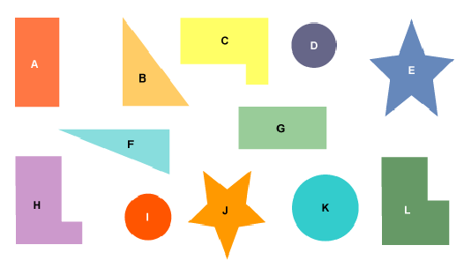
Congruence
Which shapes are the same?
Can you pair them up?

Slide 3
24
7
30
Topic: Congruence
Date:
EQ – How do we know if two triangles are congruent?
What is Congruent Shapes?
Congruent shapes have the same shape and size. They can fit exactly on top of each other.
If something is flipped, rotated or translated (slide) then it is still congruent.
If something is enlarged, shrunk or stretched it is no longer congruent.

Slide 4
For example:
✓
✓
✓
✗
✗
✗

Slide 5
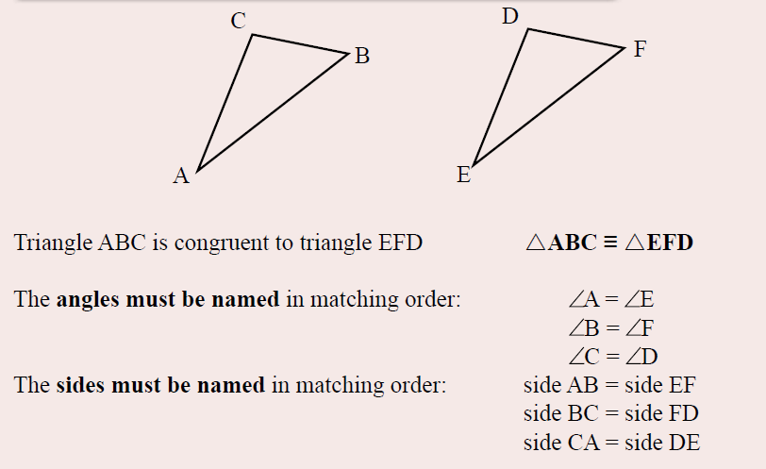

Slide 6


Slide 7
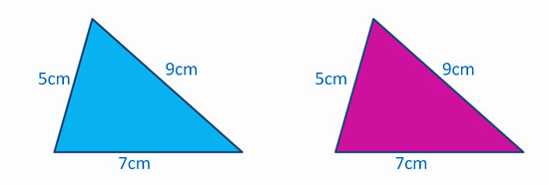
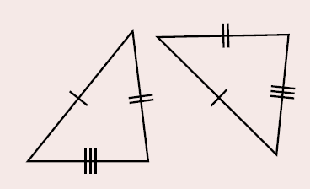
SSS Rule
Side, Side, Side Rule
Congruent if all three sides of the triangles are equal in length
Notes:
Guide students through the question.
Option 2: Dot plots handout (Scaffolded for kids who may need extra help)

Slide 8
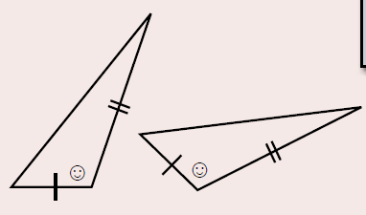
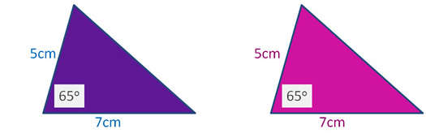
SaS Rule
Side, Angle, Side Rule
Congruent if two matching sides have equal lengths, and the angle in between these two sides is the same
Notes:
Guide students through the question.
Option 2: Dot plots handout (Scaffolded for kids who may need extra help)

Slide 9
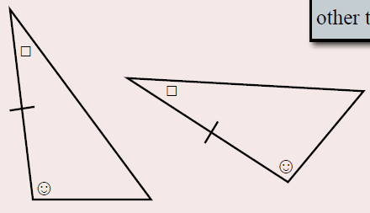
ASA Rule
Angle, Side, Angle Rule
Congruent if two angles are the same and the side length in between the angles is the same
Notes:
Guide students through the question.
Option 2: Dot plots handout (Scaffolded for kids who may need extra help)

Slide 10
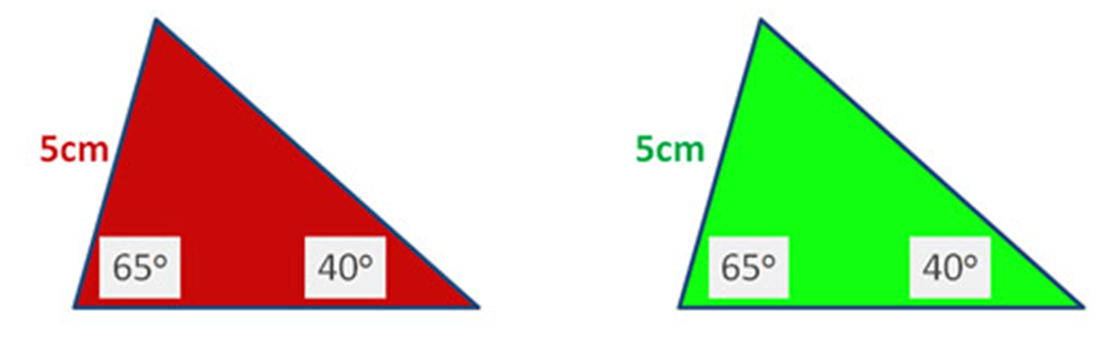
AAS Rule
Angle, Angle, Side Rule
Congruent if two angles are the same and one side is matching
Notes:
Guide students through the question.
Option 2: Dot plots handout (Scaffolded for kids who may need extra help)

Slide 11
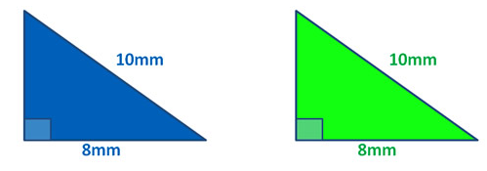
RHS Rule
Right-Angle, Hypotenuse, Side Rule
Congruent if the hypotenuse and one matching side are equal in length. They also have a 90° angle equal.
Notes:
Guide students through the question.
Option 2: Dot plots handout (Scaffolded for kids who may need extra help)

Slide 12
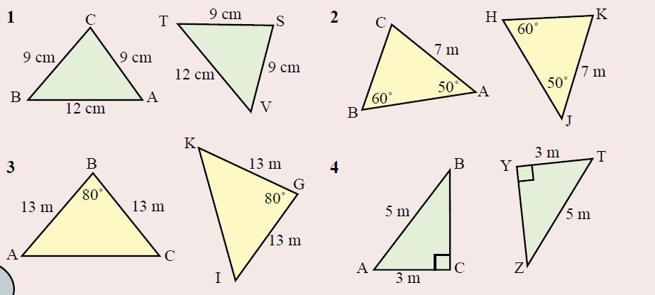
Practice
Notes:
Guide students through the question.
Option 2: Dot plots handout (Scaffolded for kids who may need extra help)

Slide 13
Task
Complete the activity sheet as your exit pass
(The HL column is the same as the RHS rule)
Get your teacher to check that you are correct before you glue in the triangles!!
Notes:
Guide students through the question.
Option 2: Dot plots handout (Scaffolded for kids who may need extra help)

